Slide 1

DEADLOCKS
VSK-PSG - Deadlock

Slide 2

Formal definition of Deadlock
A set of processes is deadlocked if each process in the set is waiting for an event that only another process in the set can cause

Slide 3
What is a deadlock?
Deadlock is defined as the permanent blocking of a set of processes that compete for system resources.
Deadlock occurs when a set of processes are in a waiting state, because each process is waiting for a resource that is held by some other waiting process.
Example
  System has 2 disk drives
  P₁ and P₂ each hold one disk drive and each needs another one
Example
  semaphores A and B, initialized to 1
        P₀ P₁
        wait (A); wait(B)
        wait (B); wait(A)
There is no efficient solution to the deadlock problem
VSK-PSG - Deadlock

Slide 4
Bridge Crossing Example
Traffic only in one direction
Each section of a bridge can be viewed as a resource
If a deadlock occurs, it can be resolved if one car backs up (preempt resources and rollback)
Several cars may have to be backed up if a deadlock occurs
Starvation is possible
Note – Most OSes do not prevent or deal with deadlocks
VSK-PSG - Deadlock

Slide 5
Classification of resources
Preemptable : these can be taken away from the process owning it without ill effect.
  E.g. memory or CPU
Non-preemptable : cannot be taken away from its current owner without causing the computation to fail.
  E.g. printer or floppy disk
Deadlock occurs when sharing reusable and non-preemptable resources.
VSK-PSG - Deadlock

Slide 6
System Model
Resource types R₁, R₂, . . ., R_{m}
    CPU cycles, memory space, I/O devices
Each resource type R_{i} has W_{i} instances.
Each process utilizes a resource as follows:
  request
  use
  release
VSK-PSG - Deadlock

Slide 7
Conditions for Deadlock
Deadlock can arise if four conditions hold simultaneously.
Mutual exclusion: only one process at a time can use a resource. Process require exclusive control of resource (not sharing)
Hold and wait: a process holding at least one resource is waiting to acquire additional resources held by other processes
No preemption: process will not give up a resource until it is finished with it.
Processes irreversible : unable to reset to an earlier state where resources not held.
These can lead to Circular wait: each process in the chain holds a resource requested by another.
VSK-PSG - Deadlock

Slide 8
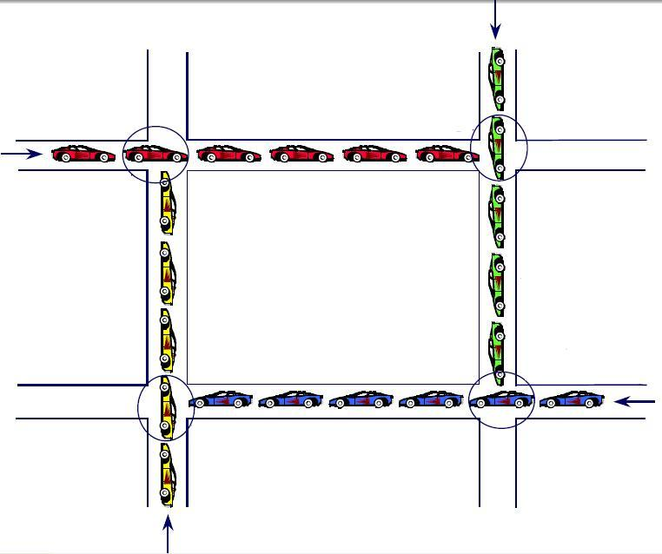
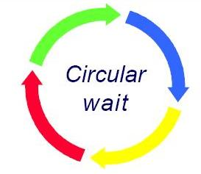
An Example
refuses to share intersection
mutual exclusion
back-up not possible
no rollback
will not give-up intersection
no preemption
holds the intersection
hold and wait
VSK-PSG - Deadlock

Slide 9
Discussion
If any one of the necessary conditions is prevented a Deadlock need not occur..
Systems with only shared resources cannot deadlock.
  Negates mutual exclusion
Systems that abort processes which request a resource that is in use.
  Negates Hold and wait
Pre-emption may be possible if a process does not use its resources until it has acquired all its need.
  Negates No preemption
Transaction processing systems provide checkpoints so that processes may back out of a transaction.
  Negates irreversible process
Systems that detect or avoid deadlocks
  Prevents cycle
VSK-PSG - Deadlock

Slide 10
Resource-Allocation Graph
A set of vertices V and a set of edges E.
V is partitioned into two types:
  P = {P₁, P₂, …, P_{n}}, the set consisting of all the processes in the system
  R = {R₁, R₂, …, R_{m}}, the set consisting of all resource types in the system
request edge – directed edge P₁ → R_{j}
assignment edge – directed edge R_{j} → P_{i}
VSK-PSG - Deadlock

Slide 11
Resource-Allocation Graph (contd…)
Process
Resource Type with 4 instances
P_{i} requests instance of R_{j}
P_{i} is holding an instance of R_{j}
P_{i}
R_{j}
P_{i}
R_{j}
VSK-PSG - Deadlock

Slide 12

Example of a Resource Allocation Graph
VSK-PSG - Deadlock

Slide 13

Resource Allocation Graph With A Deadlock
VSK-PSG - Deadlock

Slide 14

Graph With A Cycle But No Deadlock
VSK-PSG - Deadlock

Slide 15
Basic Facts
If graph contains no cycles ⇒ no deadlock
If graph contains a cycle ⇒
  if only one instance per resource type, then deadlock
  if several instances per resource type, possibility of deadlock
VSK-PSG - Deadlock

Slide 16
Strategies for deadlocks
In general, four strategies are used for dealing with deadlock
Ignore : stick your head in the sand and pretend there is no problem at all.
Prevent : design a system in such a way that the possibility of deadlock is excluded a priori.
Avoid : make decision dynamically checking whether the request will, if granted, potentially lead to a deadlock or not.
Detect : let the deadlock occur and detect when it happens, and take some action to recover after the fact.
VSK-PSG - Deadlock

Slide 17

The ostrich algorithm
The easiest way to deal with the problem:
Stick your head in the sand and
pretend that there is no problem
How is it possible to use such an algorithm?
Other errors are
much more frequent
To not add limitations to
the operating system
The ostrich algorithm is both Windows and UNIX approved!! ☺
Notes:
Give the fork example: Consider 10 programs, each program can create up to 12 processes, however it is not likely that is occurs at the same time. Say that unix can handle 100 processes max. No restrictions are used because the user might accept a crash every now and then instead of not beeing able to run all the programs.
There is a tradeoff between convenience and correctness

Slide 18
Ostrich algorithm!
Different people react to this strategy in different ways:
Mathematicians : find deadlock totally unacceptable, and say that it must be prevented at all costs.
Engineers : ask how serious it is, and do not want to pay a penalty in performance and convenience.
The Unix approach is just to ignore.
VSK-PSG - Deadlock

Slide 19
Deadlock Prevention
Very difficult to achieve
Attack one of the conditions for deadlock
  Attack Mutual Exclusion
  Attack Hold and Wait
  Attack No preemption
  Attack Circular wait
Notes:
Mutual Exclusion: Spooling (daemon pretending to be the resource, serialization by daemon) Printer Not all resources can be spooled
Hold and Wait: Initially request all resources (2 phase locking) Low utilization, should Word allocate the printer from the very start???
Preemption: Allow taking resources from a process by force. Not easily done, which one to take??
Circular wait: Always allocate resources in a predefined order, often used with semaphores…

Slide 20
Deadlock Prevention (Make it impossible to happen)
Prevent the occurrence of one of the necessary conditions.
Restrain the ways request can be made. Deadlock prevention strategies are very conservative; they solve the problem of deadlock by limiting access to resources and imposing restrictions on processes.
Mutual Exclusion – not required for sharable resources; must hold for nonsharable resources. In general, this condition cannot be disallowed.
Hold and Wait – must guarantee that whenever a process requests a resource, it does not hold any other resources
  Require process to request and be allocated all its resources before it begins execution, or allow process to request resources only when the process has none
  Low resource utilization; starvation possible
  A process is blocked until all requests can be granted.
VSK-PSG - Deadlock

Slide 21
Deadlock Prevention (Cont…)
No Preemption –
  If a process that is holding some resources requests another resource that cannot be immediately allocated to it, then all resources currently being held are released
  Preempted resources are added to the list of resources for which the process is waiting
  Process will be restarted only when it can regain its old resources, as well as the new ones that it is requesting
Circular Wait – impose a total ordering of all resource types, and require that each process requests resources in an increasing order of enumeration
VSK-PSG - Deadlock

Slide 22
Deadlock Avoidance
Avoids deadlock by cautious allocations
Safe and unsafe states
An allocation can only be granted if it puts the system in a safe state.

Slide 23
Deadlock Avoidance
Requires that the system has some additional a priori information available
Simplest and most useful model requires that each process declare the maximum number of resources of each type that it may need
The deadlock-avoidance algorithm dynamically examines the resource-allocation state to ensure that there can never be a circular-wait condition
Resource-allocation state is defined by the number of available and allocated resources, and the maximum demands of the processes
VSK-PSG - Deadlock

Slide 24
Safe State
When a process requests an available resource, system must decide if immediate allocation leaves the system in a safe state
System is in safe state if there exists a sequence <P₁, P₂, …, P_{n}> of ALL the processes in the systems such that for each P_{i}, the resources that P_{i} can still request can be satisfied by currently available resources + resources held by all the P_{j}, with j < i
That is:
  If P_{i} resource needs are not immediately available, then P_{i} can wait until all P_{j} have finished
  When P_{j} is finished, P_{i} can obtain needed resources, execute, return allocated resources, and terminate
  When P_{i} terminates, P_{i +1} can obtain its needed resources, and so on
VSK-PSG - Deadlock

Slide 25
Basic Facts
If a system is in safe state ⇒ no deadlocks
If a system is in unsafe state ⇒ possibility of deadlock
Avoidance ⇒ ensure that a system will never enter an unsafe state.
VSK-PSG - Deadlock

Slide 26

Safe, Unsafe , Deadlock State
VSK-PSG - Deadlock

Slide 27
Deadlock Avoidance
- Safe and unsafe states
Example:
  A total of 10 resources, with the following allocations:
Proc | Has | Max
A | 3 | 9
B | 2 | 4
C | 2 | 7
3
1
SAFE!!!
2
Free 3
5
7
10
Is the system in a safe or unsafe state??
Notes:
Looks into the future and predicts the worst case scenario…

Slide 28
Deadlock Avoidance
-Bankers Algorithm
Made by Dijkstra
Originating from loan allocations in a bank
Examines if an allocation leads to a safe or unsafe state
Is run when resource is requested
Two cases
  One type of resource
  Multiple types of resources

Slide 29
Deadlock Avoidance
-Bankers Algorithm
Example using one type of resource:
Initial state
A requests 1
Proc
Has
Max
Proc
Has
Max
A
3
9
A
4
9
NOT GRANTED!
B
2
4
B
2
4
C
2
7
C
2
7
Free 3
SAFE!
Free 2
UNSAFE!
B requests 1
C requests 1
Proc
Has
Max
Proc
Has
Max
A
3
9
A
3
9
GRANTED!
GRANTED!
B
3
4
B
3
4
C
2
7
C
3
7
Free 2
SAFE!
Free 1
SAFE!
Notes:
A Request one, B (4 free) Neither C or A can run, UNSAFE
B Request one, B (5 free) C (7 free) A (10 free) SAFE
C Request one, B(4 free) C (7 free) A (10 free) SAFE
Problems: Not east to know the max, bad utilization (Always assuming worst case)

Slide 30
Banker’s Algorithm
Multiple instances
Each process must a priori claim maximum use
When a process requests a resource it may have to wait
When a process gets all its resources it must return them in a finite amount of time
VSK-PSG - Deadlock

Slide 31
Data Structures for the Banker’s Algorithm
Let n = number of processes, and m = number of resources types.
Available: Vector of length m. If available [j] = k, there are k instances of resource type R_{j} available
Max: n x m matrix. If Max [i,j] = k, then process P_{i} may request at most k instances of resource type R_{j}
Allocation: n x m matrix. If Allocation[i,j] = k then P_{i} is currently allocated k instances of R_{j}
Need: n x m matrix. If Need[i,j] = k, then P_{i} may need k more instances of R_{j} to complete its task
    Need [i,j] = Max[i,j] – Allocation [i,j]
VSK-PSG - Deadlock

Slide 32
Safety Algorithm
1. Let Work and Finish be vectors of length m and n, respectively. Initialize:
      Work = Available
      Finish [i] = false for i = 0, 1, …, n- 1
2. Find an i such that Finish [i] == false AND Need_{i} ≤ Work
  If no such i exists, go to step 4
3. Work = Work + Allocation_{i}
Finish[i] = true
go to step 2
4. If Finish [i] == true for all i, then the system is in a safe state else not in the safe state
VSK-PSG - Deadlock

Slide 33
Resource-Request Algorithm for Process P_{i}
Request = request vector for process P_{i}. If Request_{i} [j] = k then process P_{i} wants k instances of resource type R_{j}
  1. If Request_{i} ≤ Need_{i} go to step 2. Otherwise, raise error condition, since process has exceeded its maximum claim
  2. If Request_{i} ≤ Available, go to step 3. Otherwise P_{i} must wait, since resources are not available
  3. Pretend to allocate requested resources to P_{i} by modifying the state as follows:
      Available = Available – Request;
      Allocation_{i} = Allocation_{i} + Request_{i};
      Need_{i} = Need_{i} – Request_{i};
    If safe ⇒ the resources are allocated to Pi
    If unsafe ⇒ Pi must wait, and the old resource-allocation state is restored
VSK-PSG - Deadlock

Slide 34
Example of Banker’s Algorithm
5 processes P₀ through P₄;
3 resource types:
A (10 instances), B (5instances), and C (7 instances)
Snapshot at time T₀:
Allocation Max Available
A B C A B C A B C
P₀ 0 1 0 7 5 3 3 3 2
P₁ 2 0 0 3 2 2
P₂ 3 0 2 9 0 2
P₃ 2 1 1 2 2 2
P₄ 0 0 2 4 3 3
VSK-PSG - Deadlock

Slide 35
Example (Cont.)
The content of the matrix Need is defined to be Max – Allocation
Need
A B C
P₀ 7 4 3
P₁ 1 2 2
P₂ 6 0 0
P₃ 0 1 1
P₄ 4 3 1
The system is in a safe state since the sequence < P₁, P₃, P₄, P₂, P₀> satisfies safety criteria
VSK-PSG - Deadlock

Slide 36
Example: P₁ Request (1,0,2)
Check that Request ≤ Available (that is, (1,0,2) ≤ (3,3,2) ⇒ true
Allocation Need Available
A B C A B C A B C
P₀ 0 1 0 7 4 3 2 3 0
P₁ 3 0 2 0 2 0
P₂ 3 0 1 6 0 0
P₃ 2 1 1 0 1 1
P₄ 0 0 2 4 3 1
Executing safety algorithm shows that sequence < P₁, P₃, P₄, P₀, P₂> satisfies safety requirement
Can request for (3,3,0) by P₄ be granted?
Can request for (0,2,0) by P₀ be granted?
VSK-PSG - Deadlock

Slide 37
Deadlock Detection
Allow system to enter deadlock state
Detection algorithm
Recovery scheme
VSK-PSG - Deadlock

Slide 38
Single Instance of Each Resource Type
Maintain wait-for graph
  Nodes are processes
  P_{i} → P_{j} if P_{i} is waiting for P_{j}
Periodically invoke an algorithm that searches for a cycle in the graph. If there is a cycle, there exists a deadlock
An algorithm to detect a cycle in a graph requires an order of n² operations, where n is the number of vertices in the graph
VSK-PSG - Deadlock

Slide 39
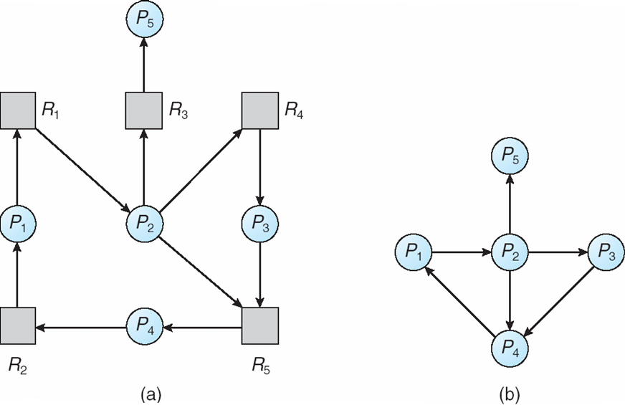
Resource-Allocation Graph and Wait-for Graph
Resource-Allocation Graph
Corresponding wait-for graph
VSK-PSG - Deadlock

Slide 40
Deadlock Detection
No limitations to resource allocations
Use algorithm to detect possible deadlock
  Two cases:
  One resource of each type
  Multiple resources of each type
Resolve any deadlock found
When should algorithm be run?
  When resource is claimed
  Periodically, every n time unit
  During idle periods

Slide 41
Deadlock Detection
- One resource of each type
Make a resource graph
Locate any cycles
Break the cycles found
Exercise:
P_{A} owns R and wants S
P_{B} wants T
P_{C} owns S
P_{D} owns U and wants S and T
P_{E} owns T and wants V
P_{F} owns W and wants S
P_{G} owns V and wants U
Is there deadlock in the system?
Process
Resource
A
B
A owns B
A
B
A wants B
“The arrow points at the
controlling node”

Slide 42
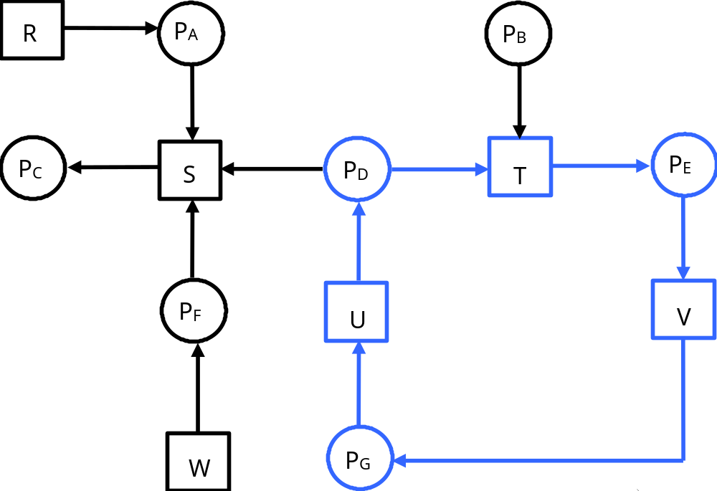
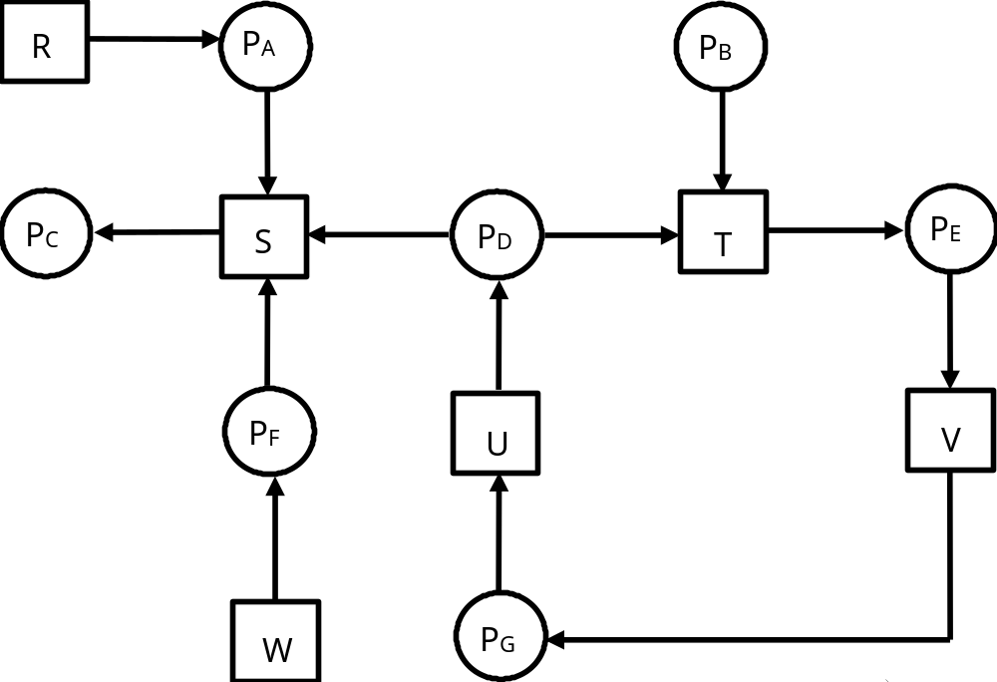
Deadlock Detection
- One resource of each type
YES!!!

Slide 43
Deadlock Detection
- One resource of each type
Algorithm for finding cycle:
For every node N in the graph, perform the following steps using N as starting node.
Initiate L as an empty set and unmark all arrows
If current node is NOT in the set, add current node to set, else deadlock is detected and the algorithm is terminated
If there are unmarked arrows from the current node go to 5 else go to 6
Randomly select one arrow and follow it.Set the new node as the current node. Go to 3
We have reached a dead end. Backtrack to previous node. If previous node is starting node go to 1 using a new starting node. If not, go to 4

Slide 44
Deadlock Detection
- One resource of each type
N=P_{B}
L={}
=>L={P_{B}}
=>L={P_{B}, T}
=>L={P_{B}, T, P_{E}}
=>L={P_{B}, T, P_{E}, V}
=>L={P_{B}, T, P_{E}, V, P_{G}}
=>L={P_{B}, T, P_{E}, V, P_{G}, U}
=>L={P_{B}, T, P_{E}, V, P_{G}, U, P_{D}}
=>L={P_{B}, T, P_{E}, V, P_{G}, U, P_{D} ,T}
Deadlock

Slide 45

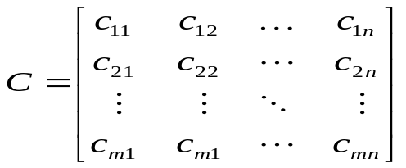
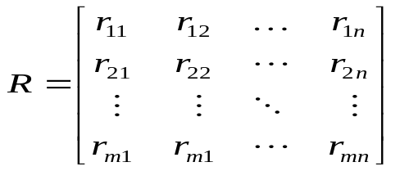
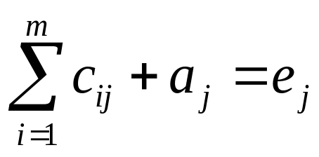
Deadlock Detection
- Many resources of each type
Solved using Matrices
A vector of existing resources of type e_{x}
A vector of available resources of type a_{x}
A matrix containing the # of resources of
Type n claimed by process m.
A matrix containing the # of resources of
Type n requested by process m.
We see that:

Slide 46

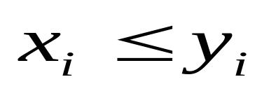
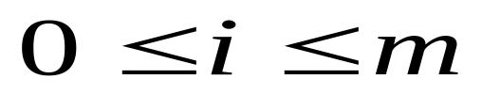
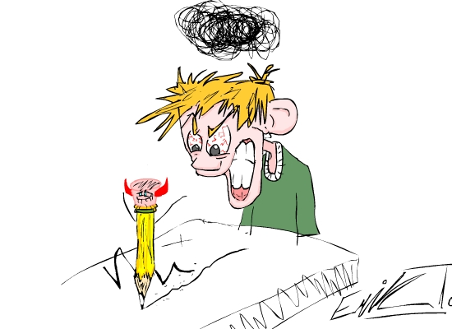
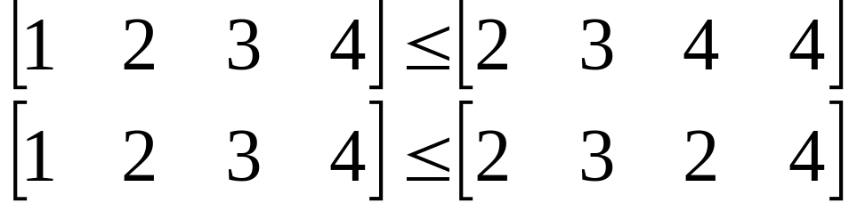
Deadlock Detection
- Many resources of each type
For two vectors, X and Y
iff
for
For example:
Notes:
X is less or equal to Y if all elements in x are less or equal to the corresponding element in y.

Slide 47

Deadlock Detection
- Many resources of each type
The detection algorithm is applied periodically
Find an unmarked process P_{i} for which R_{i} A.
If such a process is found, add C_{i} to A. Mark the process and go to step 1.
If no such process is found, terminate.
All unmarked processes are deadlocked
How on earth does this algorithm work?!?!?
Notes:
In this case C is the previously claimed resources, R is the resources claimed since last invocation.
If Pi can continue, it should (as it is now) be able to terminate and thus release all its resources (adding ci to A)
The Algorithm DOES NOT look into the future….it looks at the current state.

Slide 48


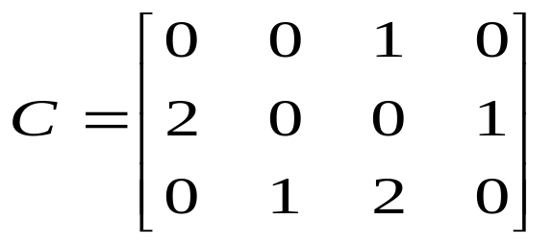
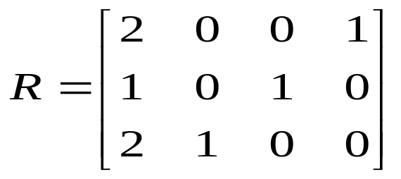



Deadlock Detection
- Many resources of each type
Exercise:
3
2
1
Is there deadlock in the system??
NO!!!

Slide 49
Deadlock Detection
How to recover from deadlock
  Preemption
  Process rollback
  Kill one of the deadlocked process’s
Notes:
Preemption – To take the resource from the process. This is very hard, in most cases impossible, consider a laser printer with several output trays….
Rollback – The OS takes continuous snapshots of the system, the system is rolled back to the last snapshot

Slide 50
Several Instances of a Resource Type
Available: A vector of length m indicates the number of available resources of each type.
Allocation: An n x m matrix defines the number of resources of each type currently allocated to each process.
Request: An n x m matrix indicates the current request of each process. If Request [i_{j}] = k, then process P_{i} is requesting k more instances of resource type. R_{j}.
VSK-PSG - Deadlock

Slide 51
Detection Algorithm
1. Let Work and Finish be vectors of length m and n, respectively Initialize:
  (a) Work = Available
  (b) For i = 1,2, …, n, if Allocation_{i} ≠ 0, then
  Finish[i] = false;otherwise, Finish[i] = true
2. Find an index i such that both:
  (a) Finish[i] == false
  (b) Request_{i} ≤ Work
  If no such i exists, go to step 4
VSK-PSG - Deadlock

Slide 52
Detection Algorithm (Cont.)
3. Work = Work + Allocation_{i}
Finish[i] = true
go to step 2
4. If Finish[i] == false, for some i, 1 ≤ i ≤ n, then the system is in deadlock state. Moreover, if Finish[i] == false, then P_{i} is deadlocked
Algorithm requires an order of O(m x n²⁾ operations to detect whether the system is in deadlocked state
VSK-PSG - Deadlock

Slide 53
Example of Detection Algorithm
Five processes P₀ through P₄; three resource types
A (7 instances), B (2 instances), and C (6 instances)
Snapshot at time T₀:
Allocation Request Available
A B C A B C A B C
P₀ 0 1 0 0 0 0 0 0 0
P₁ 2 0 0 2 0 2
P₂ 3 0 3 0 0 0
P₃ 2 1 1 1 0 0
P₄ 0 0 2 0 0 2
Sequence <P₀, P₂, P₃, P₁, P₄> will result in Finish[i] = true for all i
VSK-PSG - Deadlock

Slide 54
Example (Cont.)
P₂ requests an additional instance of type C
Request
A B C
P₀ 0 0 0
P₁ 2 0 1
P₂ 0 0 1
P₃ 1 0 0
P₄ 0 0 2
State of system?
  Can reclaim resources held by process P₀, but insufficient resources to fulfill other processes; requests
  Deadlock exists, consisting of processes P₁, P₂, P₃, and P₄
VSK-PSG - Deadlock

Slide 55
Detection-Algorithm Usage
When, and how often, to invoke depends on:
  How often a deadlock is likely to occur?
  How many processes will need to be rolled back?
    one for each disjoint cycle
If detection algorithm is invoked arbitrarily, there may be many cycles in the resource graph and so we would not be able to tell which of the many deadlocked processes “caused” the deadlock
VSK-PSG - Deadlock

Slide 56
Recovery from Deadlock: Process Termination
Abort all deadlocked processes
Abort one process at a time until the deadlock cycle is eliminated
In which order should we choose to abort?
  Priority of the process
  How long process has computed, and how much longer to completion
  Resources the process has used
  Resources process needs to complete
  How many processes will need to be terminated
  Is process interactive or batch?
VSK-PSG - Deadlock

Slide 57
Recovery from Deadlock: Resource Preemption
Selecting a victim – minimize cost
Rollback – return to some safe state, restart process for that state
Starvation – same process may always be picked as victim, include number of rollback in cost factor
VSK-PSG - Deadlock

Slide 58
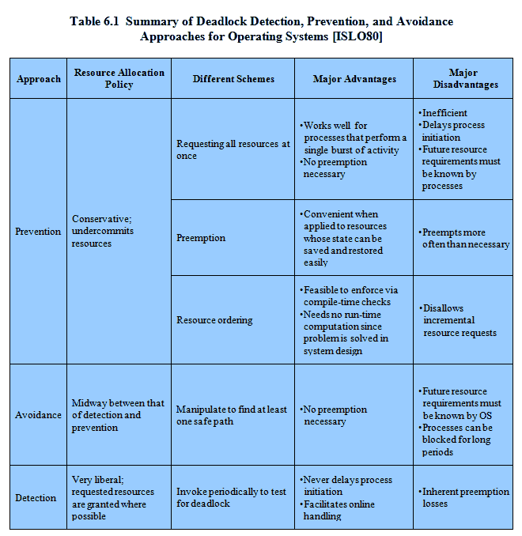
VSK-PSG - Deadlock

